Slide 1

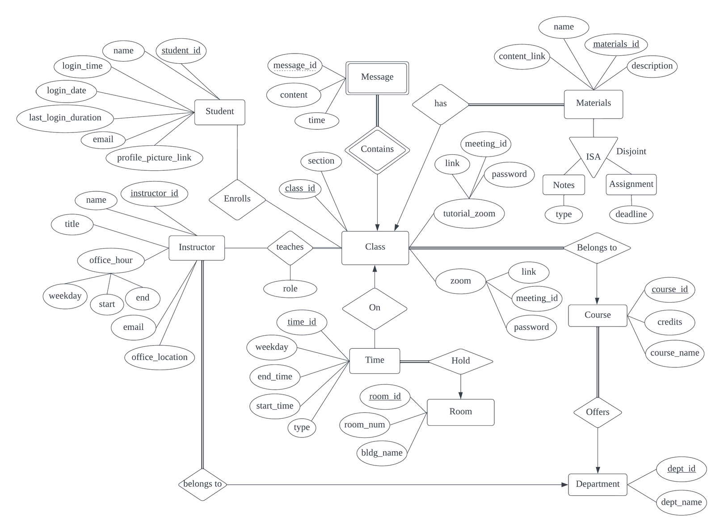
Database & Table Schema
Group 21
"Decide What You Want From Your Database"
Main Entities:
Class(class_id, course_id, section, zoom_link, zoom_meeting_id, zoom_password, tzoom_link, tzoom_meeting_id, tzoom_password)
Foreign Keys: course_id refers Course
Student(student_id, name, login_time, login_date, last_login_duration, email, profile_picture_link)
Instructor(instructor_id, dept_id, email, office_location, title, name, office_hour_start, office_hour_end, office_hour_weekday)
Foreign Keys: dept_id refers Department
Enrolls(student_id, class_id)
Foreign Keys: student_id refers Student, class_id refers Class
Time(time_id, class_id, room_id, start_time, end_time, day, type)
Foreign Keys: class_id refers Class, room_id refers Room
AND
{Department, Course, Material, Notes, Assignment, Message, Teaches, Room}

Slide 2
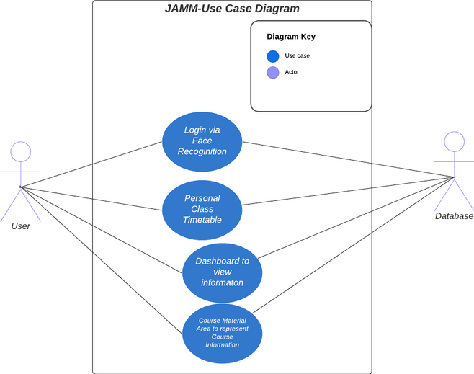
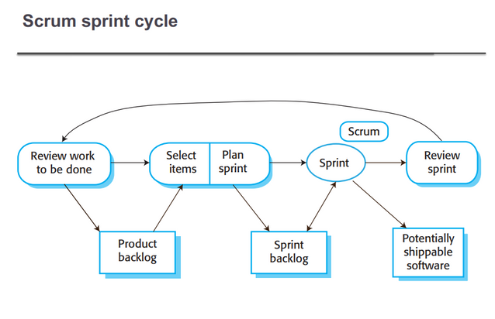
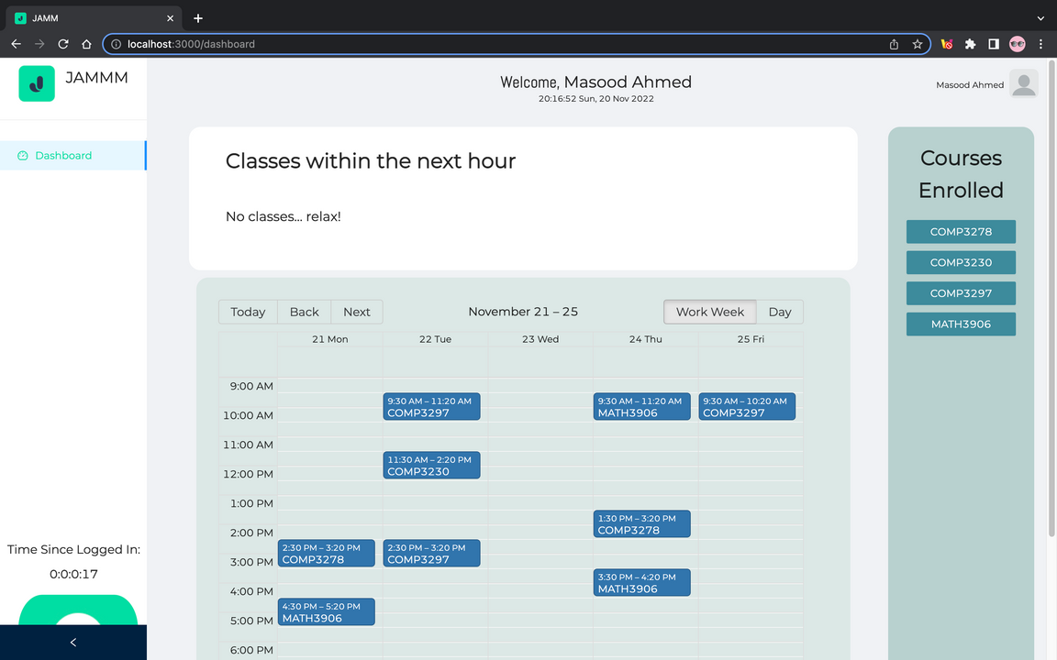
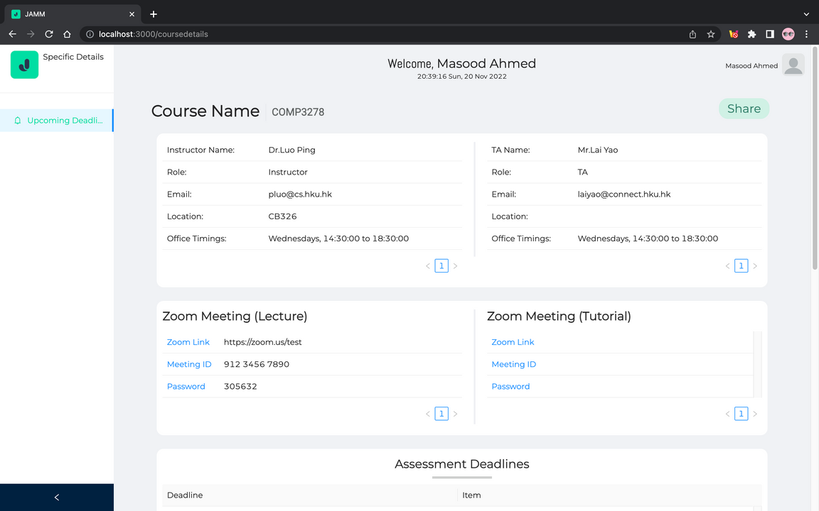
UI & Software Design
Group 21
Highlighted Functionalities:
A welcome message, along with name and login time of a student logging in with face recognition
A dashboard that displays a personalized daily and weekly timetable spanning the entire semester
A reminder that shows the upcoming class within the next hour
Course material page that shows useful details, such as lecture notes or deadlines, for each course a student has enrolled in
Opportunity to automatically share this information with anyone by email.
Monitoring student activity using sessions
Technology | Purpose
MySQL | Database
Python + Flask | Backend
React.JS | UI Framework and Frontend
Python + OpenCV | Face Recognition
Dashboard
Course Material Page

Slide 3

Development Process & Contributions
Group 21
Backend Development with Flask and integration with MySQL Database
Cleaning code, fixing bugs,
and optimizing
Slides and Video
Presentation
Software, Database
& UI design
Frontend Development
with React.JS
Backend, Face Recognition
and Frontend Integration
Problems Faced | Solutions
Version Control | Used advanced features of Git such as stash and revert while making changes in different branches and merging them after reviewing the code.
React.JS, Flask and Face Recognition Integration | Using proxy, we defined the API path for the frontend to fetch data from the backend and have a consistent JSON format to send and receive the data. We also used efficient use of hooks to coherently render the desired components.
Database Design - tedious SQL queries with regards to tables with weak entity set | Implement strong entity set to make the development process more efficient
Group Members | Contributions
Masood Ahmed | Frontend + UI + Frontend-Backend Integration + Face-Recognition
Abdulwadood Ashraf Faazli | Database Design + Backend + Frontend-Backend integration
Muhammad Mubeen | Frontend + UI + Frontend-Backend Integration + Face Recognition
Li Hoi Kit | Database Design + SQL Queries + Backend
Chan Kwok Cheung | Database Design + SQL Queries + Backend

